Slide 1

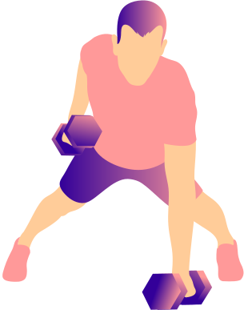
Bodybuilder Physique Predictor
By: Yeabsira Feleke - 22020107054
START NOW

Slide 2
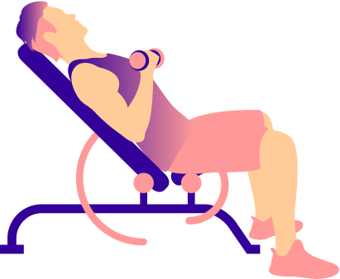
A comprehensive Overview
The Bodybuilder Physique Predictor is a React-based web application powered by machine learning (ML) that offers personalized predictions for body composition metrics like muscle mass and body fat percentage. It's designed for users who want data-driven insights into their fitness journey, along with actionable recommendations

Slide 3
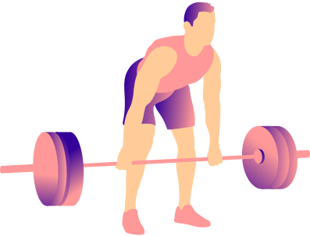
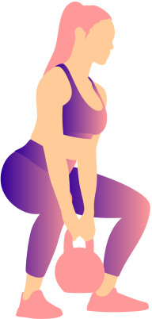
Project Breakdown
Frontend
Framework: React.js is used to build the user interface. React's component-based architecture ensures modularity, scalability, and ease of testing.
Tailwind CSS: A utility-first CSS framework that simplifies styling through pre-defined classes. This ensures the app has a modern, responsive, and professional look.
State Management
React Hooks:
useState Manages application state, such as toggling between input and results views (showResults) and storing computed predictions (results).

Slide 4
Component Structure
InputForm
ResultSection
Gathers user inputs (age, weight, height, gender, activity level).
Key Features:
Validation for inputs (e.g., age between 15–80).
Dropdowns for selecting gender and activity level.
Submission triggers handleSubmit to process data.
Displays predictions and recommendations.
Key Features:
Confidence score visualization.
Progress bars for muscle mass and body fat.
Detailed recommendations for fitness improvement.
01
02
ProgressBar
App.jsx
Visual representation of percentage metrics.
Key Features:
Customizable labels and colors.
Displays percentages for predicted metrics (e.g., 70% muscle mass).
Acts as the main orchestrator.
Workflow:
Shows InputForm.
On Submission:
Calls helper functions to calculate predictions.
Passes results to ResultSection for rendering.
Reset Functionality:
Clears results and toggles back to input mode
03
04

Slide 5

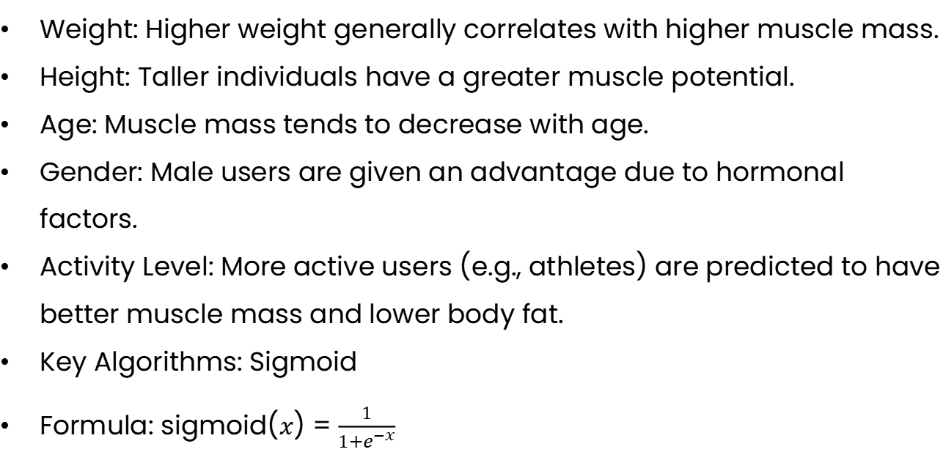
Machine Learning Model
Mathematical Model
The app employs a set of equations (defined in ML_PARAMS) to compute predictions. These are parameterized based on:
Weight: Higher weight generally correlates with higher muscle mass.
Height: Taller individuals have a greater muscle potential.
Age: Muscle mass tends to decrease with age.
Gender: Male users are given an advantage due to hormonal factors.
Activity Level: More active users (e.g., athletes) are predicted to have better muscle mass and lower body fat.
Key Algorithms: Sigmoid
Formula: sigmoid($x$) = $\frac{1}{1+e^{−x}}$

Slide 6
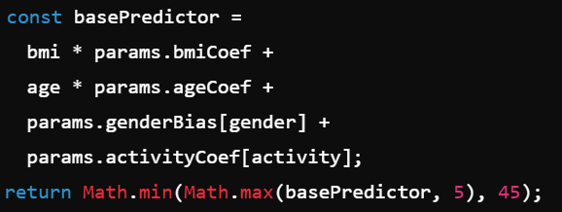
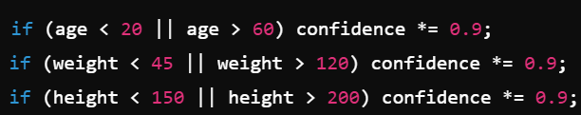
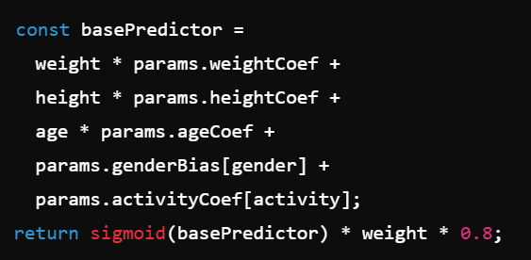
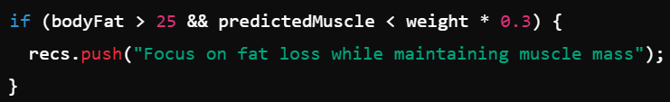
Prediction Formulas Using JavaScript
Muscle Mass Predictions
Body Fat Predictions
Confidence Calculations
Recommendations
Adding Noise

Slide 7

Setting up the Project
Conclusions
Future Enhancements
Backend Integration:
Enable user profiles and progress tracking.
Advanced AI Models
Nutrition Recommendations:
Provide meal plans tailored to individual goals.

